Slide 1
Anesthesia for Pituitary Surgery
By Siryet Tesfaye

Slide 2
Pituitary Tumors
The pituitary gland is located at the base of the skull in the sella turcica, a bony cavity within the sphenoid bone
Divided into anterior (adenohypophysis) and posterior (neurohypophysis) lobes.

Slide 3
Adenohypophysis
Hormone Secreted Clinical Disease
ACTH Cushing’s disease
TSH Hyperthyroidism
GH Acromegaly
FSH and LH
Prolactin Prolactinoma

Slide 4
Cont…
Secretion of each of these hormones is regulated by hypothalamic peptides (releasing hormones) that are transported to the adenohypophysis by a capillary portal system.
Feedback Mechanisms

Slide 5
Neurohypophysis
The posterior pituitary secretes
ADH( vasopressin) and
Oxytocin

Slide 6
Cont…
Tumors of the anterior pituitary can be “functioning” or “nonfunctioning”;
Functioning tumors are often initially manifested by symptoms of hormonal excess.
Prolactinsecreting tumors are the most common type of functioning pituitary adenomas

Slide 7
Preoperative Diagnosis and Management
Elevated hormone levels, and imaging techniques.
Magnetic resonance imaging(MRI) is technically superior in the identification of microadenomas,as well as CT

Slide 8
Preoperative Assessment
Focus on the identification and management of
1) raised ICP
2) the effects of hormonal hypersecretion.

Slide 9
Syndromes of Hormonal Hypersecretion
Acromegaly
The clinical manifestations of excess GH secretion that are of particular concern to anesthetists are
Upper airway
Cardiac, and
Respiratory involvement.

Slide 10
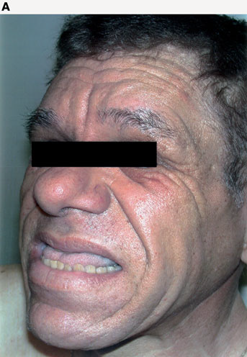
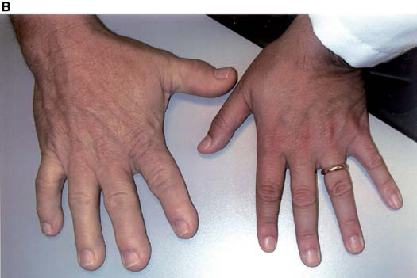

Slide 11
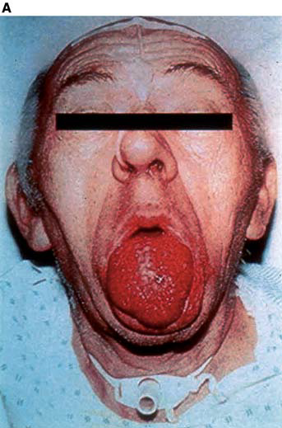
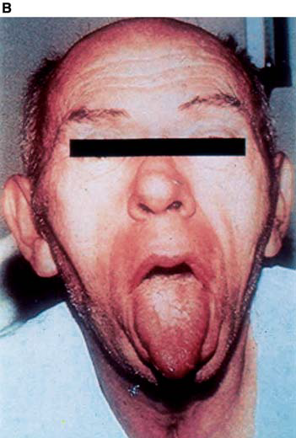

Slide 12
Cont…
Gigantism (prepubertal patients) or acromegaly (adults).
After epiphyseal closure, the abnormal growth is limited to soft tissues and acral parts: hands, feet, nose, and mandible.

Slide 13
Upper airway changes include
Macroglossia
prognathism with malocclusion, and
hypertrophy of the
laryngeal soft tissue,
epiglottis, and aryepiglottic folds
leading to a reduction in size of the glottic opening.

Slide 14
Cont…
OSA should also be sought inasmuch as nearly 70% of acromegalic individuals have either a peripheral or, more uncommonly, a central form of OSA

Slide 15
Cardiac effects
left ventricular hypertrophy with or without
hypertension
interstitial myocardial fibrosis and resultant cardiomyopathy
small-vessel coronary artery disease,SVT and
Disorders of conduction.
Impaired glucose tolerance and diabetes mellitus occur in up to 25% of patients

Slide 16
Cushing’s syndrome
Coexisting hypertension is common and usually multifactorial:
increased cardiac output,
increased activation of the renin-angiotensin system through enhanced hepatic production of angiotensinogen, and
Reduced synthesis of vasodilatory prostaglandins.

Slide 17
Organ Systems Affected | Clinical Features
Cardiorespiratory | Hypertension Increased sensitivity to endogenous and exogenous vasopressors Left ventricular hypertrophy and strain Congestive cardiac failure Obstructive sleep apnea
Electrolyte imbalance | Hypokalemia, hypernatremia

Slide 18
Organ Systems Affected | Clinical Features
Endocrine | Diabetes mellitus
Musculoskeletal Miscellaneous | Osteoporosis, aseptic necrosis of the hip, vertebral crush fractures, proximal myopathy, capillary fragility Obesity, polycythemia, decreased wound healing, thin skin, gastroesophageal reflux

Slide 19
Investigations
Electrolyte
cardiovascular evaluation for ischemic heart disease and congestive heart failure.

Slide 20
Cont…
visual examination
When transsphenoidal surgery is planned,
an otolaryngologic examination of the nasal passages and nasopharynx is also performed,
Nasal culture is obtained to guide antibiotic therapy in the event of postoperative infection.

Slide 21
Surgical approach
Transnasal or transseptal transsphenoidal access to the sella.
Optimal removal of larger tumors and decompression may require a craniotomy.
Newer techniques such as the endoscopic endonasal approach have allowed superior visualization of both the sellar and suprasellar components of these tumors.

Slide 22
Major Problems Associated with the Transsphenoidal Approach
1) the need for mucosal injections of epinephrine-containing solution
2) the accumulation of blood and tissue debris in the pharynx and stomach

Slide 23
Cont…
3) the risks of hemorrhage from inadvertent entry into the cavernous sinus or the internal carotid artery
4) cranial nerve damage, and
5) pituitary hypofunction.
6) possibility of CSF leakage and meningitis

Slide 24
Advantages of the transsphenoidal approach
include the following:
lower morbidity and mortality rates
Decreased incidence and severity of DI
Elimination of frontal lobe retraction and external scars

Slide 25
Cont…
Magnified visualization and removal of small tumors, which spares normal tissue
Decreased frequency of blood transfusions; and
Shorter hospitalization.

Slide 26
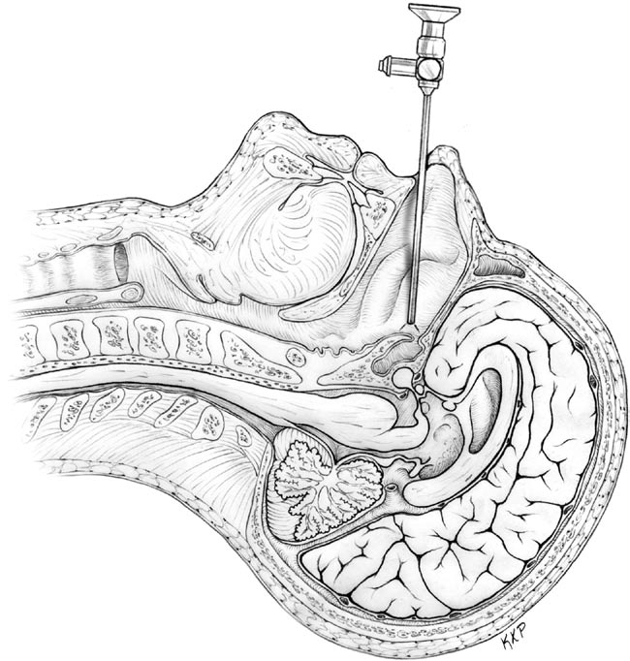

Slide 27
Transcranial approach
Transcranial approach to the sella permits direct visualization of suprasellar structures.
Transcranial approach is advisable in significant suprasellar extension with optic nerve or hypothalamic involvement.

Slide 28
Airway Management
Direct laryngoscopy may require the use of a long blade.
awake fiberoptic intubation
A throat pack(sphenoidal approach)

Slide 29
Anesthetic Considerations.
Adherence to the general principles of neurosurgical anesthesia is more crucial to a successful outcome than the choice of drugs.
However, the use of short-acting drugs allows rapid awakening at the end of surgery.
Perioperative steroid supplementation is routinely administered.

Slide 30
Cont…
Iv antibiotic prophylaxis and glucocorticoid coverage are usually given prior to induction.
Avoid nitrous oxide to prevent problems with a postoperative pneumocephalus.
Intense neuromuscular blockade is important to prevent movement while the surgeon is using the microscope.

Slide 31
Monitoring
Monitoring should be carried out in somewhat the same way as for craniotomies.
VEP may be employed with large tumors that involve the optic nerves.
Precordial Doppler sonography may be used for detecting venous air embolism.
Venous access with large-bore catheters is desirable in the event of massive hemorrhage.

Slide 32
Postoperative Care
Emergence should be smooth and rapid to prevent dislodgement of nasal packs or stents and also to allow early neurologic assessment.
Ensure airway patency(OsA)
Nausea and vomiting are common(prophylactic antiemetics)
Pain management(moderate-severe)
Careful management of fluid balance & electrolyte.

